Slide 1
Secret Sharing Protocols -Publicly Verifiable Secret Sharing
Christopher Foley

Slide 2
Outline
Verifiable Secret Sharing
Original Verifiable Secret Sharing Algorithm
Research since 1985
Publicly Verifiable Secret Sharing
Future Trends and Applications

Slide 3
Disclaimer
Lots of things in this fields
Originally wanted to work with Stinson and Wei’s paper
Then Stadler
Then Gan, et al.
Then Wu & Tseng
If I had 2 more weeks then I’d probably do Jeppsen & Lemming (Voting) or probably Chen, et al. (Executing wills online)

Slide 4
History
1979 – basic secret sharing schemes proposed
Assumed all participants honest
1987 – Feldman proposed first Verifiable secret sharing (VSS)
Allowed participants to verify their shares but not others
1996 – Stadler introduced first Publicly Verifiable Secret Sharing (PVSS)
Verify shares held by any participant without revealing own shares

Slide 5
Overview
PVSS has numerous applications
Electronic voting
Key escrow systems
Commerce
Anonymous cash exchange
Signature authentication
Revocable authority
Authentication of Last Will and Testament

Slide 6
New Developments
Elliptic Curves
Weil pairing in 1993
Joux – identity based encryption, signature algorithm (2000)
Pairing Based cryptography
Signatures (2002)
Key agreement protocols (2002)
Signcryption algorithms (2005)

Slide 7
General Model of PVSS
Three Phases
Initialization phase
Distribution Phase
Reconstruction Phase

Slide 8
General Model of PVSS
Initialization Phase
All public parameters, private and public keys generated
Dealer and Participants Identified

Slide 9
General Model of PVSS
Distribution Phase
Distribution of the shares: Dealer uses participants public keys and public parameters to compute values and the share of the secret to the participants
Verification of the shares: Any share may be verified by any party. If all shares are verified then the parties believe that the shares contain the secret and the dealer is uncorrupted. If any share fails, the dealer is corrupted and the scheme aborts.

Slide 10
General Model of PVSS
Reconstruction:
Decryption of shares: participants use private key to decrypt share
Reconstruct secret: The secret may be reconstructed from some of the participants.

Slide 11
Pairing-Based PVSS
{U₁,U₂,…,U_{n}} are participants
The Dealer, D, wishes to distribute a secret to the participants

Slide 12
Pairing-Based PVSS
Initialization Phase
The key generation system generates the public parameters Param={G₁,G₂,q,c,P,P_{pub},H}
Each participant chooses a private key α_{i} ∈ ℤ_{q} and computes the Public key P_{i}=α∙P_{pub} for i=1..n

Slide 13
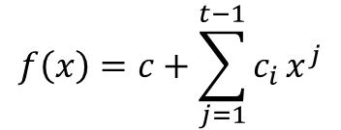
Pairing-Based PVSS
$$f\left(x\right)=c+\sum_{j=1}^{t−1}{c_{i}}x^{j}$$
Distribution Phase
(Decryption of the shares)
The dealer chooses a random polynomial
Of degree t-1 with coefficients in ℤ_{q}

Slide 14
Pairing-Based PVSS
Distribution Phase
(Decryption of the shares)
The dealer selects random numbers r_{i} ∈ ℤ_{q}
The dealer then computes C_{j}=c_{j}∙P, X_{i}=f(i)∙P, Y_{i}=c(P_{i},P_{pub})^{f(i)}, α_{i}=r_{i}∙P, β_{i}=r_{i}∙P_{i}, h_{i}=H(P_{i},X_{i},Y_{i,} α_{i} , β_{i}), γ_{i}=(r_{i}+h_{i}∙f(i))∙P_{pub} for j=0,1,..,t-1 and i=1..n

Slide 15
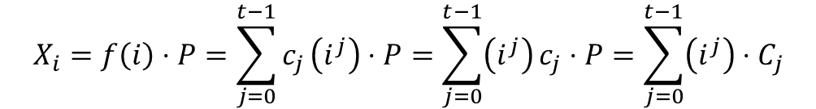
Pairing-Based PVSS
$$X_{i}=f\left(i\right)⋅P=\sum_{j=0}^{t−1}{c_{j}}\left(i^{j}\right)⋅P=\sum_{j=0}^{t−1}{\left(i^{j}\right)}c_{j}⋅P=\sum_{j=0}^{t−1}{\left(i^{j}\right)}⋅C_{j}$$
Distribution Phase
(Decryption of the shares)
The dealer then publishes all C_{j} and σ_{i}=(Y_{i,},α_{i}, β_{i}, γ_{i}) to all participants.
Note: each X_{i} can be reconstructed from:

Slide 16
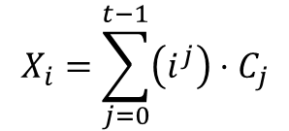
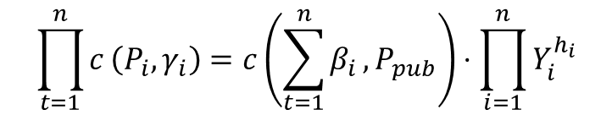
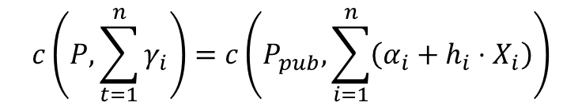
Pairing-Based PVSS
$$X_{i}=\sum_{j=0}^{t−1}{\left(i^{j}\right)}⋅C_{j}$$
$$c\left(P,\sum_{t=1}^{n}{γ_{i}}\right)=c\left(P_{pub},\sum_{i=1}^{n}{\left(α_{i}+h_{i}⋅X_{i}\right)}\right)$$
$$\prod_{t=1}^{n}{c}\left(P_{i},γ_{i}\right)=c\left(\sum_{t=1}^{n}{β_{i}},P_{pub}\right)⋅\prod_{i=1}^{n}{Y_{i}^{h_{i}}}$$
Distribution Phase
Verification of the shares
Participants recover then checks two equations:
and

Slide 17
Pairing-Based PVSS
Distribution Phase
Verification of the shares
If these checks do not fail, the participants may assume that the shares distributed by the dealer are uncorrupted.

Slide 18
Pairing-Based PVSS
$$Y^{{α_{i}}^{−1}}=c{\left(P_{i},P_{pub}\right)}^{f\left(i\right)α_{i}^{−1}}=c{\left(α_{i}P_{pub},P_{pub}\right)}^{f\left(i\right)α_{i}^{−1}}=c{\left(P_{pub},P_{pub}\right)}^{f\left(i\right)}=S_{i}$$
Reconstruction Phase
Decryption of shares:
Each participant uses their private key to decrypt their share

Slide 19
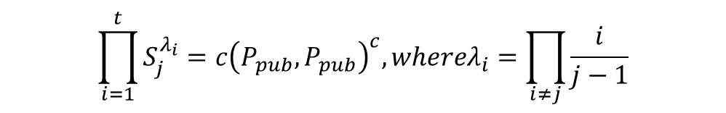
Pairing-Based PVSS
$$\prod_{i=1}^{t}{S_{j}^{λ_{i}}}=c{\left(P_{pub},P_{pub}\right)}^{c},whereλ_{i}=\prod_{i≠j}{\frac{i}{j−1}}$$
Reconstruction Phase
Interpolation
Any t shareholders U_{i} with shares S_{i} may join to reconstruct the secret

Slide 20
Conclusions
PVSS is a growing field with opportunities.
PVSS has a number of applications being developed (2011) including:
Key Escrow
Electronic Voting
Electronic Cash

Slide 21
References
M. Nojoumian, Lecture Notes, COT6427 Secret Sharing Protocols, Florida Atlantic University, Spring 2018
B.Chor, S. Goldwasser, S. Micali, B. Awerbuch. Verifiable Secret Sharing and Achieving Simultaneity in the Presence of Faults. Proceedings of the 26th IEEE Symposium on the Foundations of Computer Science (FOCS), pp. 383-395, 1985
M. Stadler. Publicly Verifiable Secret Sharing. U. Mauer(Ed.) Advances in Cryptography – EUROCRYPT ‘96, LNCS 1070,
S. Jepsen, K. Lemming. Electronic Voting Application Based on Public Verifiable Secret Sharing. Masters Thesis, Department of Mathematics, Aalborg University, 2016
T. Wu, Y. TSENG. A Pairing-Based Publicly Verifiable Secret Sharing Scheme, Journal of Systems Science & Complexity, Feb 2011 24:186-194

